Slide 1
NETFLIX USERBASE DATASET ANALYSIS
N VAMSI
AP21110010844

Slide 2
CONTENTS
Abstract
Introduction
System Requirements
Importing library
Loading dataset
Data Analysis
Data Visualization
Advantages
Conclusion
Reference

Slide 3
ABSTRACT
The main objectives of this analysis are to understand user preferences, identify trends in subscription adoption, and visualize key metrics for better decision-making.

Slide 4
INTRODUCTION
Netflix, a leading online streaming platform, has revolutionized the way people consume entertainment content. With millions of subscribers worldwide, it has become essential to understand user behavior and subscription patterns to optimize service offerings and enhance customer satisfaction.

Slide 5
SySTEM REQUIREMENTS
SOFTWARE
HARDWARE
Python Library
Jupyter Nootebook
DBMS(SQL)
Processor
RAM
Storage
Graphics Card

Slide 6
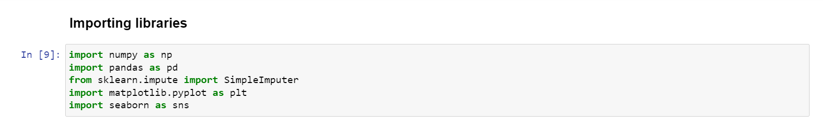
Importing LIBRARIES

Slide 7
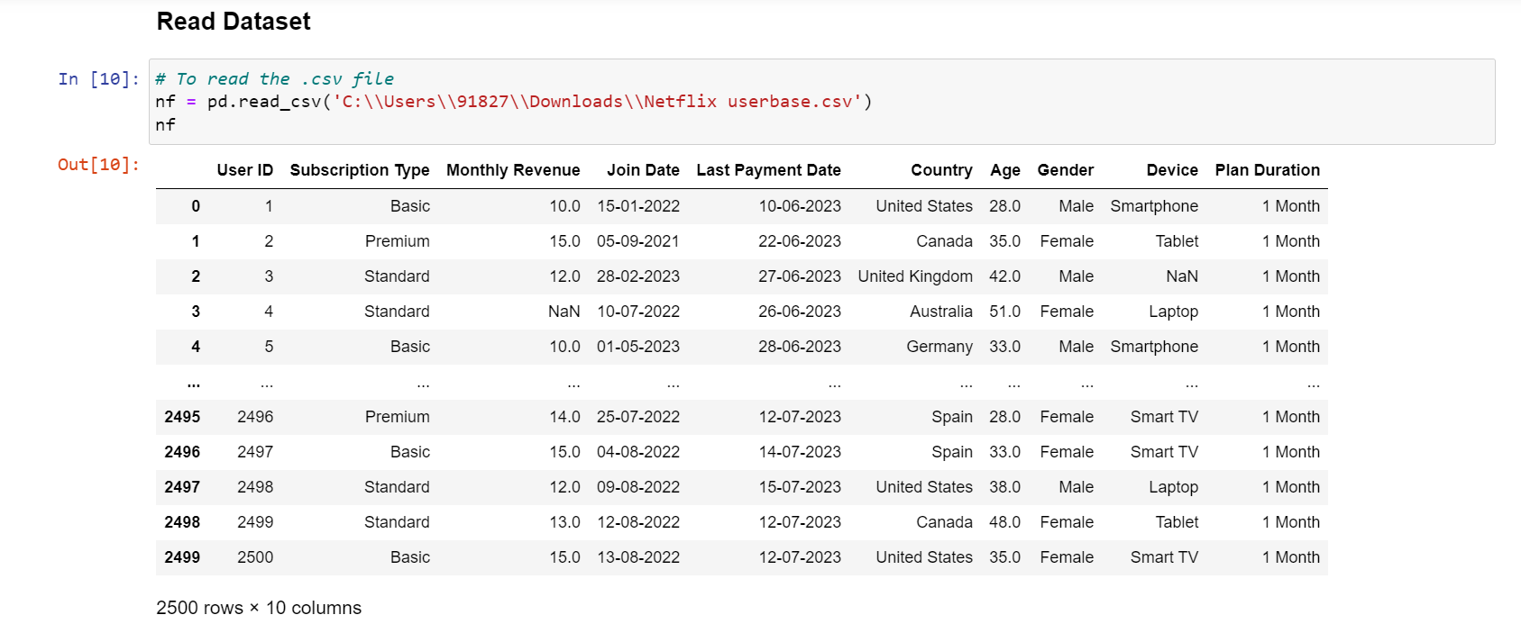
LOADING DATASET

Slide 8
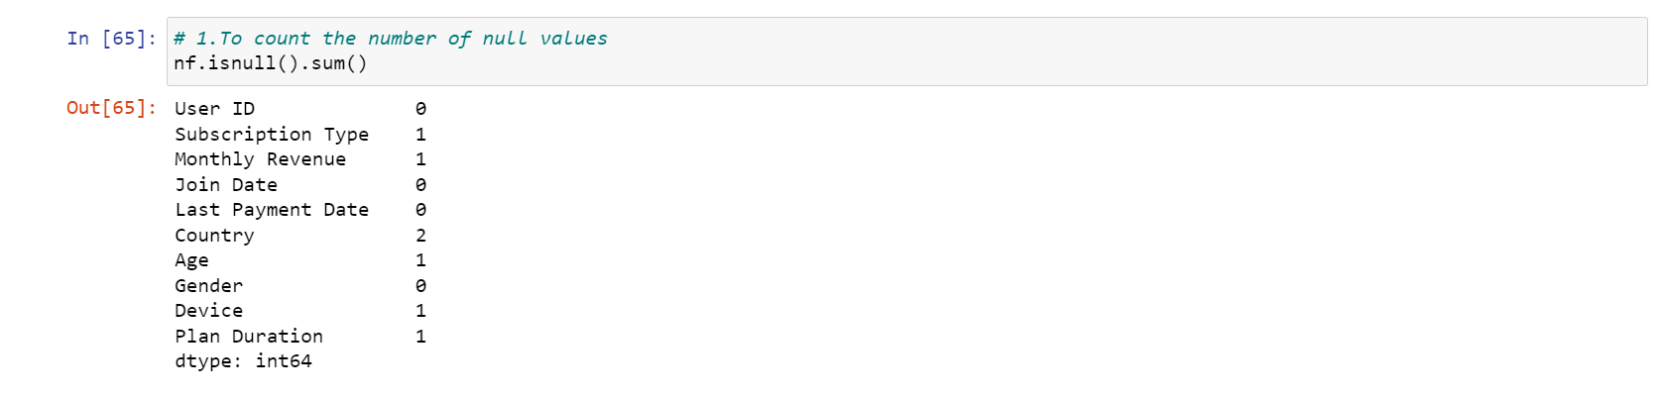
DATA CLEANING

Slide 9
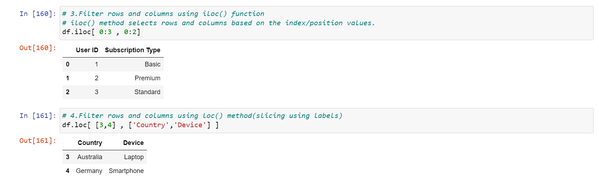
DATA FILTERING

Slide 10
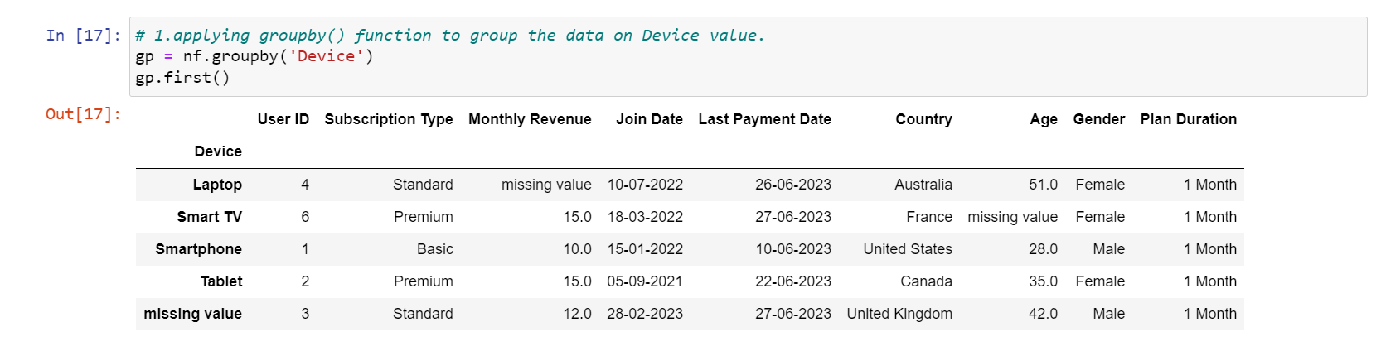
GROUPING

Slide 11
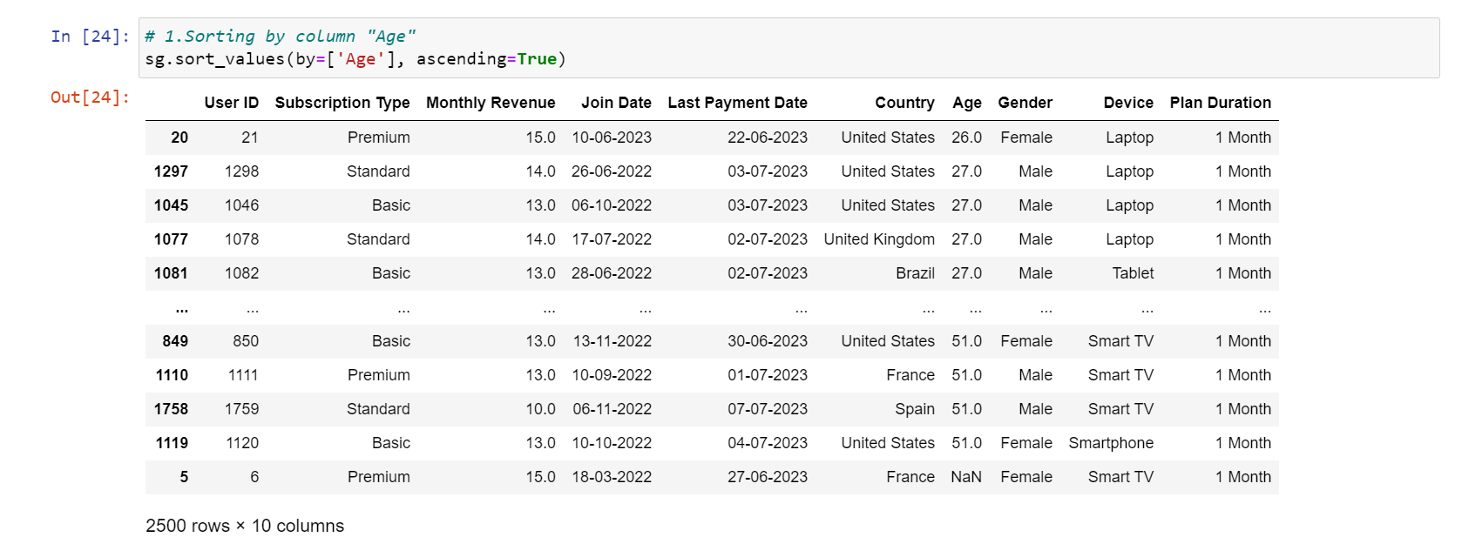
SORTING

Slide 12
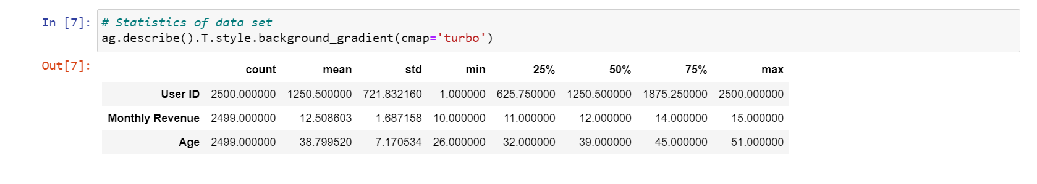
AGGREGATIONS

Slide 13
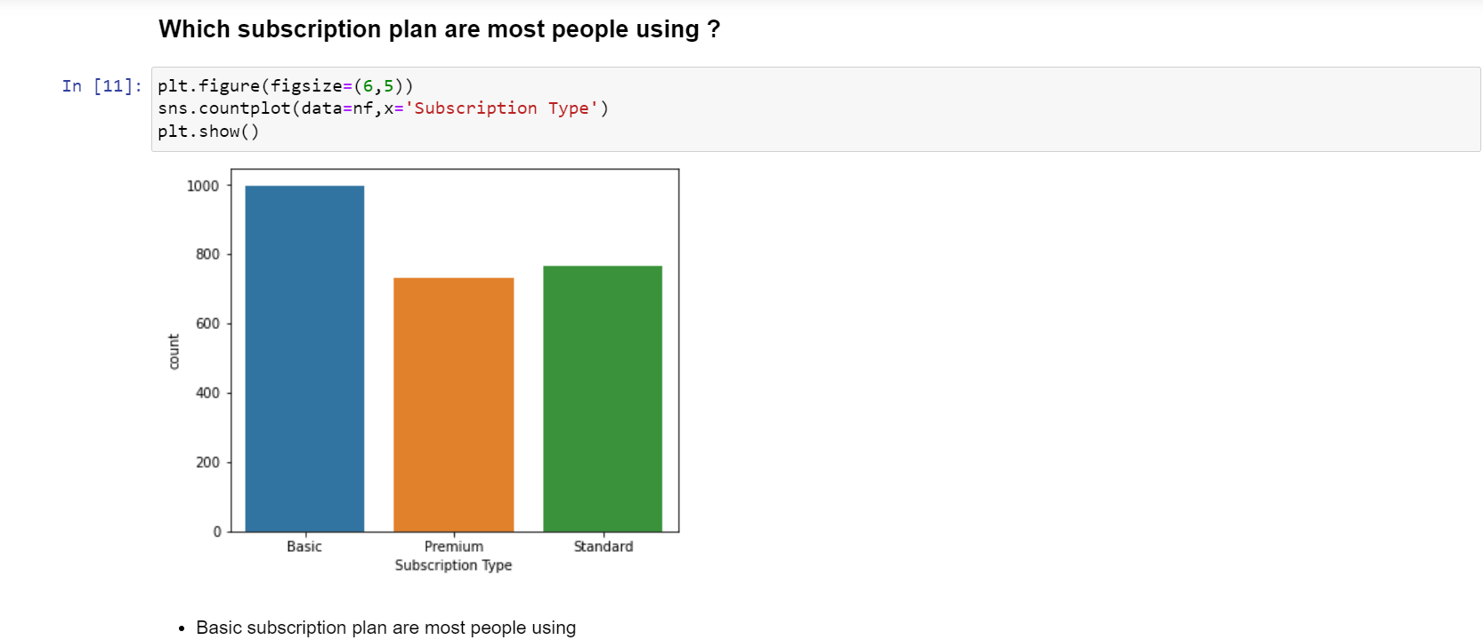
DATA VISUALIZATION

Slide 14
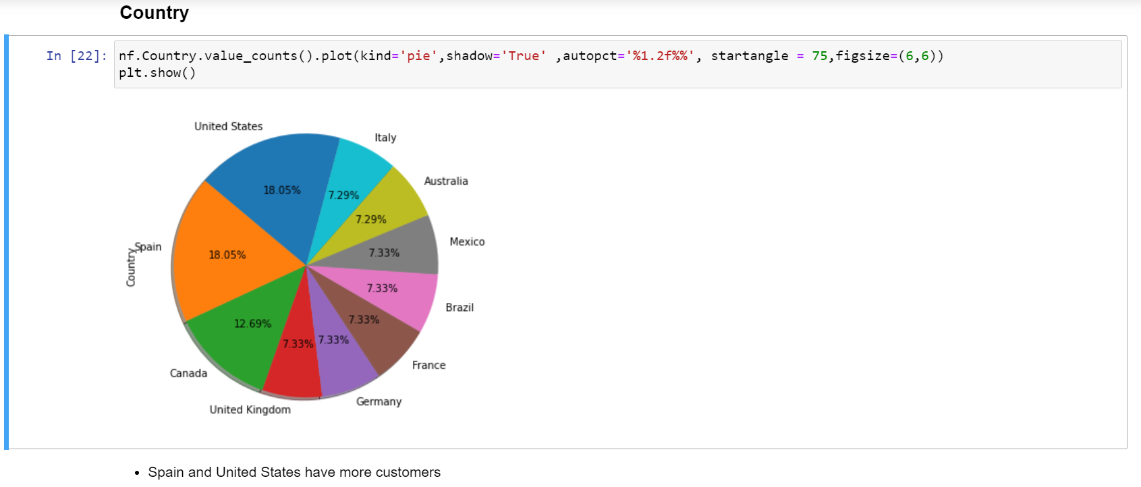
Pie chart

Slide 15
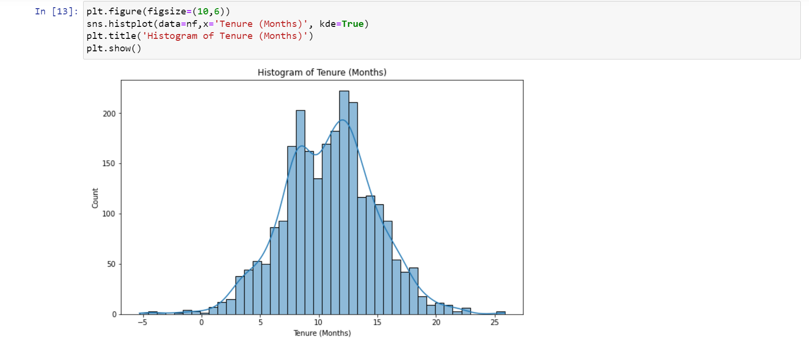
Histogram

Slide 16
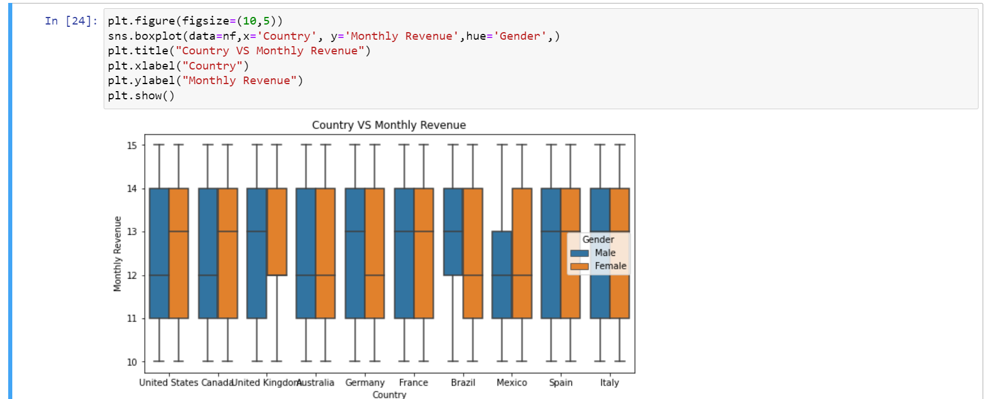
Box plot

Slide 17
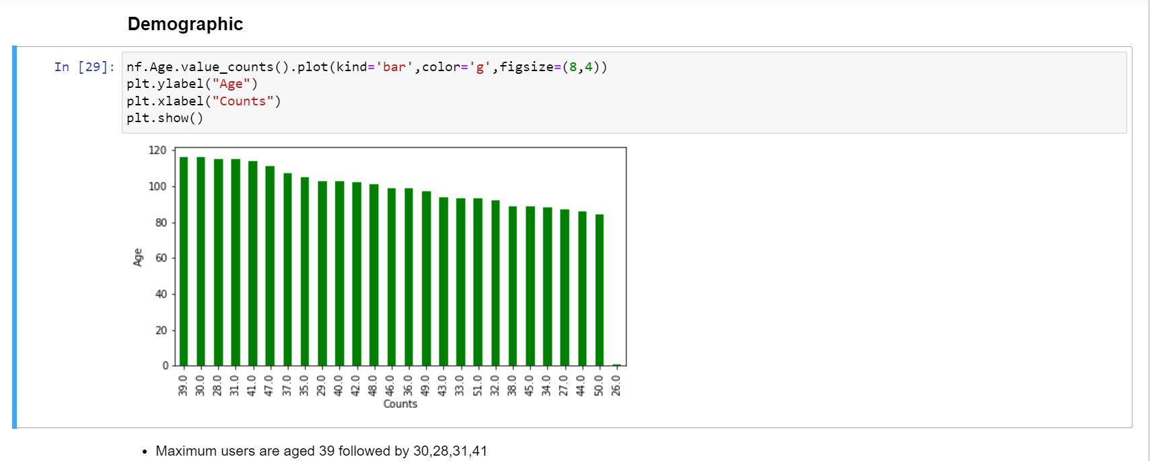
Bar graph

Slide 18
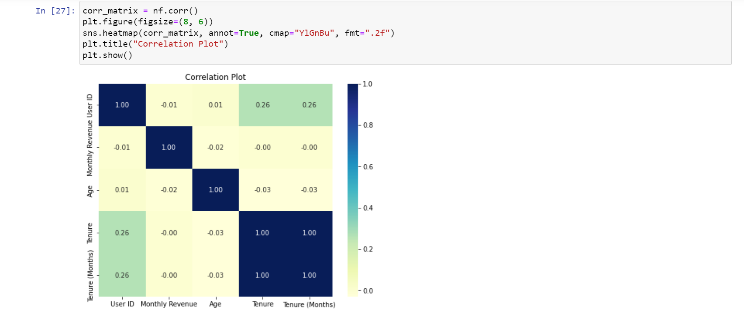
Heatmap

Slide 19
Final insights
Age group 20-29 spend more time on Netflix
All countries have similar rate of spending time
Tenure (months) distribution is bimodal if it has two modes.
Age group 30-49 doing the most subscription and giving more revenue
Basic type subscription has maximum purchasing

Slide 20
ADVANTAGES
Understanding User Preferences
Revenue Trends and Growth
Demographic Profiling
Device Usage Insights
Plan Duration and User Retention

Slide 21
Conclusion
The Project also sheds light on user retention, helping Netflix focus on strategies to increase customer loyalty and reduce subscription cancellations.

Slide 22
Future scope
The future scope could involve predictive modeling for churn prevention, content recommendation enhancements, and refining subscription plans based on user segments.

Slide 23
REFERNCE WEBSITES
https://www.kaggle.com/

Slide 24


